Slide 1




Pre-Meeting with the Design Team:
the proposed new Base Schema (task 6.6)
NB: M6.1: Base Schema proposals ready for review and adoption by Design Team in mth 6!
4D4Life Opening Meeting, 15-17 September, Reading, UK

Slide 2



Existing documents (out of sync):
1. Standard Data Set v3.2 dec2004 (YR):
to document the data and its meaning for users and providers
2. Common Data Model v1.21(RW):
to describe how data should be passed around the system.
Neither document describes how the data should be stored.
NB the Standard Data Set was updated on the website in 2008 (extra LSID field), but not the document.
The Base Schema should be:
a ‘logical schema’ outlining how the information described in these documents should be arranged in a relational database; all the (relational) databases used in the infrastructure should be compatible with this.
4D4Life Opening Meeting, 15-17 September, Reading, UK

Slide 3
Logical schema: how the data might be arranged in tables in a relational database
The Base Schema will NOT be:
a conceptual schema (model of the data items and how they relate to each other)
physical or implementation schema (actual table and field definitions with data types, primary and foreign keys)
Currently there are six different database schemas across the CoL:
  AC production DB,
  AC assembly DB,
  Data Exchange Templates,
  SPICE caches,
  Dilshat's Downloader (not used?),
  Jorrit's Optimised Schema (ERD only, not used?)
Most of these schemas (including SPICE cache & CDM) are not
matching with the Standard Dataset, only the templates are up-to-date.
4D4Life Opening Meeting, 15-17 September, Reading, UK

Slide 4
Purpose of the Base Schema:
All the (imported/converted) data sets being used in the system should have a fully compatible set of information, with the same interpretations and constraints being applied. This makes it easier to develop tools or tests to work with these datasets.
The Base Schema proposal is an early milestone in 4D4Life because:
It is needed for the unification of AC and DC workflows and
To move DC from research prototype into a production stage.
A ‘final’ Base Schema will not be delivered because it may need changes/additions in the future if extra fields are proposed by WP3 or it may need to change for the new e2 infrastructure (if, by example, e2 will use triple stores instead of relational databases the proposed base schema would need to change)
4D4Life Opening Meeting, 15-17 September, Reading, UK

Slide 5
Standard data set:
1. Accepted Scientific Name linked to References (obligatory)
2. Synonym(s) linked to Reference(s) (obligatory, as appropriate)
3. Common Name(s) linked to Reference(s) (optional)
4. Latest taxonomic scrutiny (obligatory)
5. Source Database (obligatory)
6. Additional Data (optional)
7. Family name (obligatory)
8. Classification above family, and highest taxon (obligatory, as appropriate)
9. Distribution (optional)
10. Reference(s)
11. LSID (new field since 2008)
4D4Life Opening Meeting, 15-17 September, Reading, UK

Slide 6
CDM fields (without combined fields and request information)
Nomenclatural and Taxonomic concept
PreferredHigherTaxon string
TaxonName string (returned for higher taxon request)
Rank one of species, subspecies, variety, or string representing higher taxon rank
GenusPrefix string containing things like ×, etc.
Genus string
SpecificPrefix string containing things like ×, cf. etc.
SpecificEpithet string
InfraspecificEpithet string
Suffix string containing any additional unstructured name information or comment
Status one of accepted, provisional, synonym, unambiguous, variant, infraspecific, ambiguous, proparte, misapplied, doubtful.
Authority string (possibly including the date of publication and other conventional details)
VirusName string [is a Name]
4D4Life Opening Meeting, 15-17 September, Reading, UK

Slide 7
Common name
VernName string
Language string
PlaceName string (representing the name of geographical area(s) or location(s0, preferably TDWG)
Reference
Title string
Author string
Details string (details of publication, excluding author, date and title; may be a URL)
Reference LitRef or a Link
RefType one of validity, acceptance, synonymy, misapplication, correction
Scrutinity data
Day integer in the range 1 to 31 inclusive
Month integer in the range 1 to 12 inclusive
Year positive 4-digit integer
Person string
Record Metadata
Identifier string representing the identifier of a Taxon (not LSID?)
Comment string (arbitrary displayable information chosen by the GSDO)
DataLink consists of Link, Metadata string
NameCode string representing a GSD’s internal code for a name or taxon
Occurrence one of native, introduced, uncertain, absent
4D4Life Opening Meeting, 15-17 September, Reading, UK

Slide 8
GSD/Wrapper Metadata
CDMVersion string representing the number 1.21
CharacterEncoding string representing the particular encoding of characters used by the wrapper
ContactLink link (to an email address or a page giving contact information)
Description string
LogoLink link (to the GSD’s or GSDO’s logo)
GSDIdentifier string representing the Identifier of the HigherTaxon of a GSD, or a “HubIdentifier”
GSDShortName string
GSDTitle string
Version string, representing a number
WrapperVersion string, representing a number
HomeLink link (to the GSDO’s home page or their main page describing the GSD)
View (?) string
Day integer in the range 1 to 31 inclusive
Month integer in the range 1 to 12 inclusive
Year positive 4-digit integer
4D4Life Opening Meeting, 15-17 September, Reading, UK

Slide 9
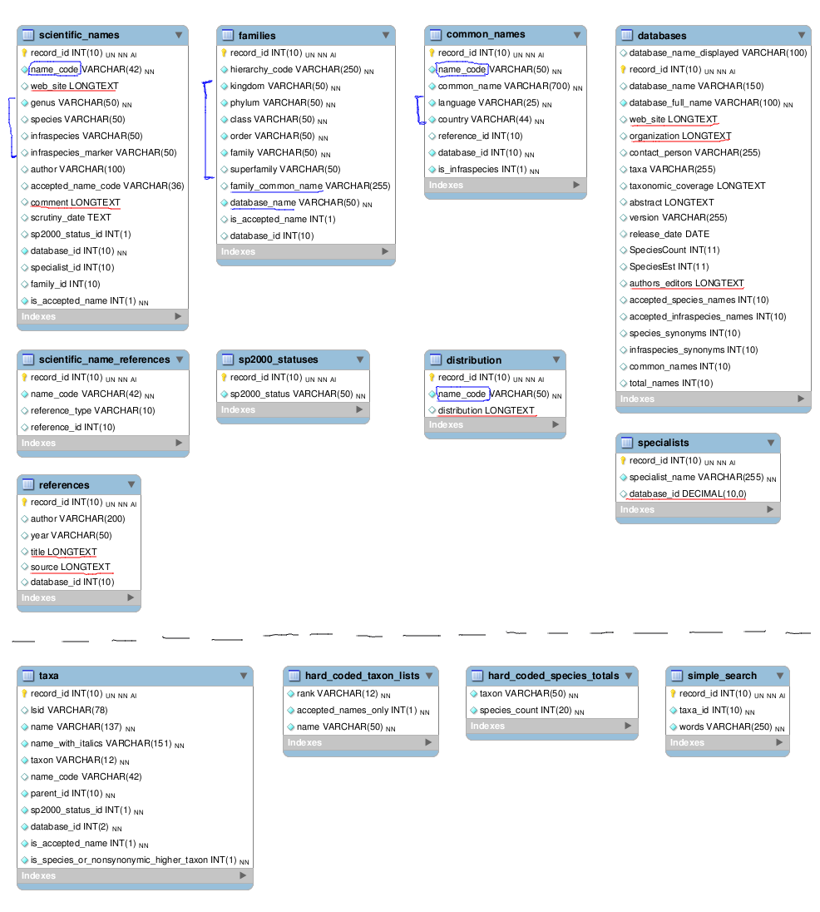
AC Database tables
4D4Life Opening Meeting, 15-17 September, Reading, UK

Slide 10
AC Additional database tables generated by optimizer tool (performance reasons)
4D4Life Opening Meeting, 15-17 September, Reading, UK

Slide 11
AC Database issues:
Improper field type definitions
LONGTEXT reserves 1.000.000.000 characters, a number high over the real need.
In case of id fields, their type should be UNSIGNED (TINY|MEDIUM)INT, never DECIMAL which is actually a text field.
Relationships between tables should be through numeric IDs instead of text fields (example: name_code). In order to normalize the data, auxiliary tables instead of plain fields may be used to reference other entities. This is done, for instance, with the statuses and should be applied to all the elements that can be considered an entity by themselves - such as taxonomic types.
Encoding: The common names contain non-standard characters, hence they have to be stored in the database using the right encoding (UTF-8) to make them sortable and searchable, and to enable compatibility with the interacting applications.
Foreign keys: Data integrity cannot be ensured unless the relatioships between fields and tables are strictly defined.
Indexes: Need to be reviewed by analyzing the multiple ways used to access the data.
Naming: Field and table names should be renamed to a consistent and standarized naming model to improve its readability.
Consistency: To ensure the consistency of the data, it may be taken into consideration to automatically generate extra tables needed for performance using triggers, instead of a tool generating them.
4D4Life Opening Meeting, 15-17 September, Reading, UK

